Slide 1

PRESENTATION OF DATA COMMUNICATION AND NETWORKING
Munib (2019-cs-037)
Maaz (2019-CS-042)
Asjad (2019-cs-005)

Slide 2
Routing Algorithm
It gives the route or path for data packets to transfer from source to destination. It helps in preventing traffic problems and become a efficient network system. After a data packet leaves its source, it can choose among the many different paths to reach its destination.
Routing is the process of forwarding of a packet in a network so that it reaches its intended destination

Slide 3
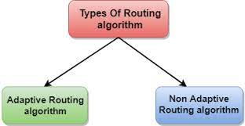
Types of Routing Algorithm
A. ADAPTIVE ALGORITHM
1. CENTRALIZED ALGORITHM
2. ISOLATED ALGORITHM
3. DISTRIBUTED ALGORITHM
B. NON-ADAPTIVE ALGORITHM
1. FLOODING
2. RANDOM WALKS

Slide 4
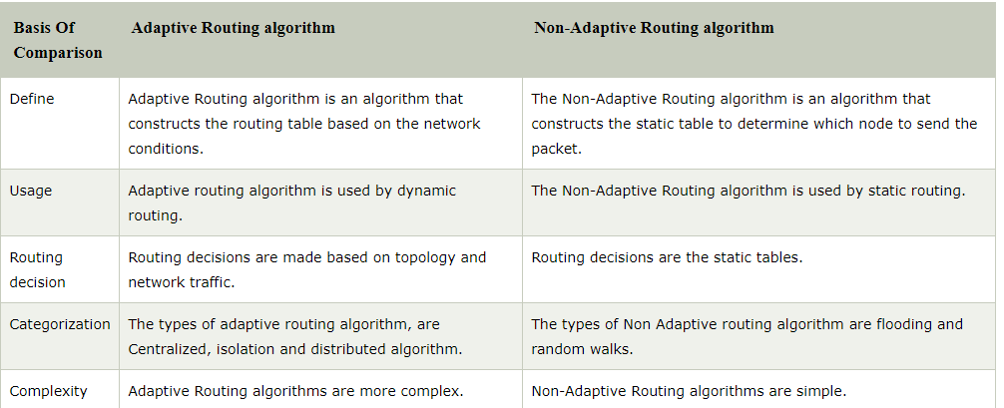
ADAPTIVE AND NON-ADAPTIVE ALGORITHM

Slide 5
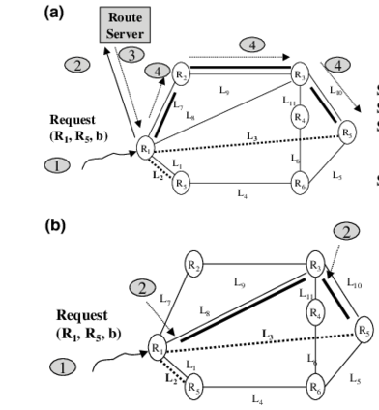
ADAPTIVE ALGORITHM(CONTD.)
1. CENTRALIZED ALGORITHM
It finds the least-cost path between source
and destination nodes by using global knowledge
about the network. So, it is also known as
global routing algorithm.

Slide 6
ADAPTIVE ALGORITHM(COUNTD..)
2. ISOLATED ALGORITHM
Routing decision are made only on the basis of information available locally in each node
3. DISTRIBUTED ALGORITHM − This is a decentralized algorithm that computes the least-cost path between source and destination iteratively in a distributed manner.

Slide 7
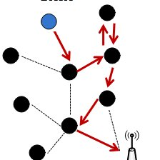
NON ADAPTIVE ALGORITHM
FLOODING − In flooding, when a data packet arrives at a router, it is sent to all the outgoing links except the one it has arrived on. Flooding may be uncontrolled, controlled or selective flooding.
RANDOM WALKS − This is a probabilistic algorithm where a data packet is sent by the router to any one of its neighbors randomly.

